Slide 1
Learn JavaScript with fun, build an UFO hunter game BOM, the Browser Object Model

Slide 2
BOM, the Browser Object Model overview
The Browser Object Model (BOM) is used to interact with the browser. The browser object model (BOM) is a hierarchy of browser objects that are used to manipulate methods and properties associated with the Web browser itself.
The BOM Hierarchy
Objects that make up the BOM
window
The window object represents the browser window.
location
history
screen
navigator
document
The location object contains information about the current URL.
The history object contains the URLs that have been visited by the user.
The screen object and the navigator object contains information about the visitor's screen.
The document object represents an html document. It forms DOM (Document Object Model).

Slide 3
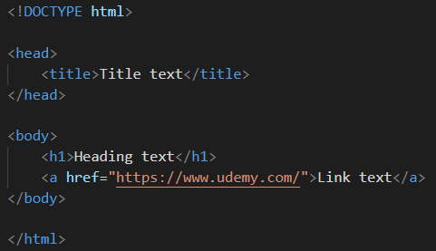
DOM tree of objects
The HTML DOM document object is the owner of all other objects in your web page.
document
Root element:
<html>
Element:
<head>
Element:
<title>
head
Text:
”Title text”
Element:
<body>
body
Element:
<h1>
Text:
”Heading text”
DOM tree
code
Element:
<a>
Attribute:
href
Text:
”Link text”

Slide 4
BOM, the Browser Object Model overview
The Browser Object Model (BOM) is used to interact with the browser. The browser object model (BOM) is a hierarchy of browser objects that are used to manipulate methods and properties associated with the Web browser itself.
The BOM Hierarchy
Objects that make up the BOM
window
The window object represents the browser window.
location
history
screen
navigator
document
The location object contains information about the current URL.
The history object contains the URLs that have been visited by the user.
The screen object and the navigator object contains information about the visitor's screen.
The document object represents an html document. It forms DOM (Document Object Model).

